Slide 1


PRABHNEET SINGH
Loan Prediction with ML Models

Slide 2



INTRODUCTION
Overview of Loan Eligibility Prediction using ML

Slide 3

Overcoming Hurdles
CHALLENGES FACED
Navigating the complexities in the loan eligibility prediction process can be daunting. However, with strategic planning and the right tools, these challenges can be effectively addressed to achieve accurate results.

Slide 4

Empowering Data
DATA PREPROCESSING
Prepare to embark on a journey of cleaning and transforming data, unlocking its full potential for powerful Machine Learning models. Just as a sculptor chips away at a block of marble to reveal a masterpiece, data preprocessing is the art of refining raw data into actionable insights.

Slide 5

KNN ALGORITHM
Understanding K-Nearest Neighbors Algorithm in ML

Slide 6

DECISION TREE
Exploring Decision Tree Algorithm for Loan Predictions

Slide 7
Assessing Model Performance
Explore various techniques to evaluate the effectiveness and efficiency of machine learning models in predicting loan eligibility, such as confusion matrices, accuracy scores, and ROC curves. By thoroughly analyzing model performance, we can make informed decisions on which algorithm works best for our specific use case.

Slide 8
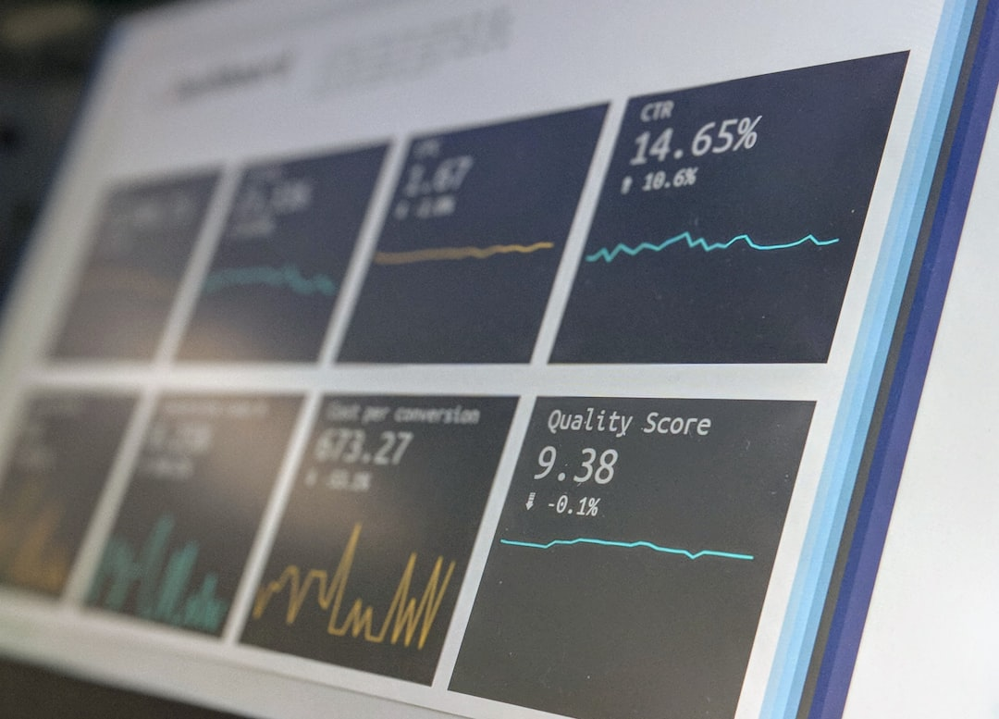


Results Analysis
INSIGHTS REVEALED
VISUAL DATA
DECISION IMPACT
Uncover key findings
Present with clarity
Drive strategic actions

Slide 9


Future Improvements
REFINED ACCURACY
INTERACTIVE VISUALIZATION
Utilize advanced techniques
Engage with data visually
PERSONA A
PERSONA B
PERSONA C
To enhance the accuracy of predictive models, we must delve deeper into advanced machine learning techniques such as deep learning and ensemble methods. By refining our algorithms and data preprocessing, we can achieve unparalleled accuracy in loan eligibility predictions.
Integrating interactive visualization tools into our models will not only make the results more understandable but also empower stakeholders to interact with the data and gain valuable insights. By making the information visually appealing, we enhance the overall presentation of loan eligibility predictions.
Short description – age, gender, lifestyle, etc

Slide 10
IMPLEMENTATION STRATEGIES
Deploying ML Models for Real-world Applications
PREPARE RELEASE
ALPHA
BETA: PHASE 1
BETA: PHASE 2
PROCESSING FEEDBACK
LAUNCH

Slide 11
CONCLUSION
Summarizing the Impact of ML in Loan Predictions

